Slide 1
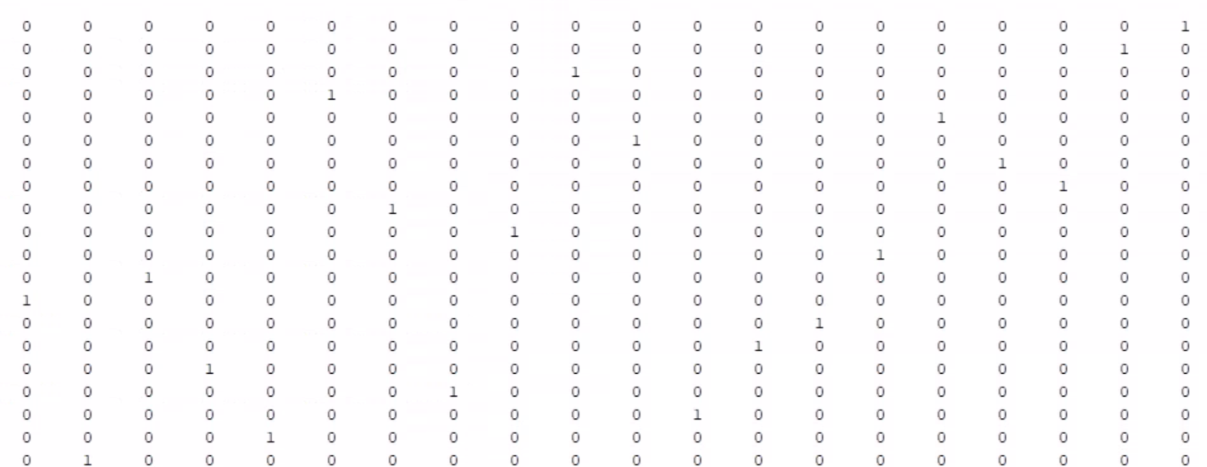
Implementing the GRA Algorithm in MATLAB
Evan Wells

Slide 2


Chapter 1: The idea
The goal of my final project can be summarized into the following points:
Familiarizing myself with the MATLAB environment
with matrices (built-in functions, operations, etc.)
Using MATLAB to do numerous matrix evaluations
Using MATLAB to successfully assign the optimal agents using Group Role Assignment (GRA)

Slide 3

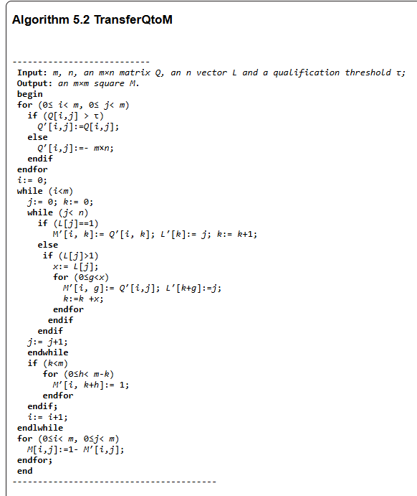

Chapter 2: The Gameplan
Using Dr. Zhu’s book, I was able to deduce the process from the algorithms provided.
Although the pseudocode did not exactly apply, it provided enough of a guideline to derive some semblance of procedure to follow the goal.

Slide 4

Chapter 3:
The Implementation
The implementation include 6 functions:
transferQtoM
prepKM
KM_Algorithm
primeZero
deriveT
GRA

Slide 5
Chapter 3:
The Implementation
transferQtoM: This function prepares the matrix for the Hungarian algorithm (K-M algorithm). It consisted of only adding important columns and returning a square matrix)
prepKM: This function preprocesses M to do the initial steps of the K-M algorithm. It reduces each row and column so that there is at least one zero in each row and column.
KM_algorithm: This is the main function of the project. Through numerous loops, flags and what seemed like arbitrary steps, this function would return the optimal assignment for each row(agent) to each column(role)
primeZero: Function to simplify the KM_algorithm function. Returns Boolean primeFound and its according index.
deriveT: This function simply changes the format of the result found in the K-M algorithm to match the input given to the transferQtoM function.
GRA: This final function puts together all the other functions to properly provide the resulting T matrix.

Slide 6

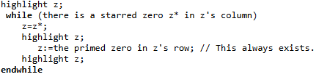


Chapter 4: Disaster
With my limited skillset in this domain, I encountered issues within the K-M algorithm. Mainly due to:
The ambiguity and range of interpretation in the pseudocode
The complexity of working with numerous flags
Very specific conditions are abundant in the algorithm

Slide 7

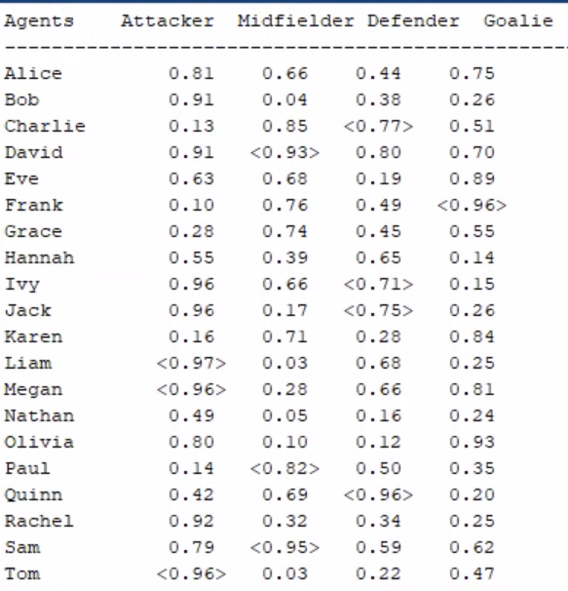

Chapter 5: Success
After numerous hours of troubleshooting and essentially redefining the algorithm, I was finally able to achieve proper optimized assignment.
The scenario provided is a soccer coach attempting to optimize his lineup depending on the formation [4-3-3]
L = [3 3 4 1]
Q = arbitrary 20 x 4 matrix

Slide 8



Chapter 6: Finale
Overall, I learnt a lot about MATLAB, implementing algorithms and working within a matrix

